Slide 1

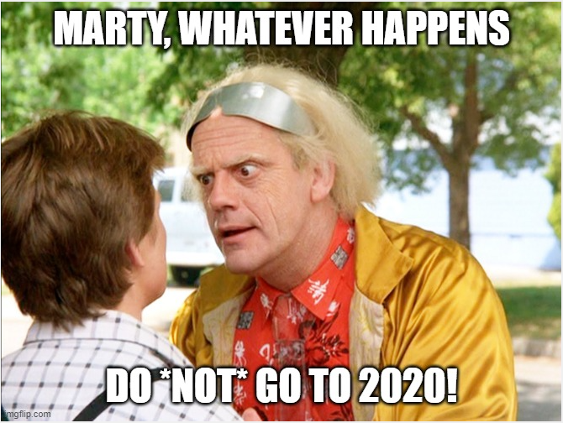

Burnout
more than just a bad day!
Seth Petry-Johnson
Psst…. I’m hiring!
Developer:
bit.ly/AwesomeJobForDevs
Test Engineer:
bit.ly/AwesomeJobForTester

Slide 2
Burnout
more than just a bad day!
Seth Petry-Johnson
Notes:
Welcome to my talk on burnout.
Let’s set the stage for this session by going back in time to 2020.

Slide 3
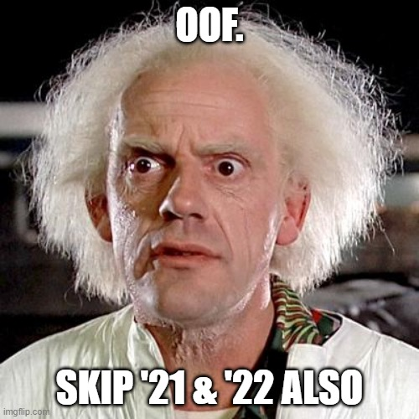
Burnout
more than just a bad day!
Seth Petry-Johnson
Notes:
You might remember that there was some stuff going down. There was a pandemic, there were politics, and basically the general upheaval of everything in our lives.
Lots of people were stressed out. Some were being forced to suddenly work from home, whether or not they wanted to do so or had an area of their home that was conducive to it.
Other people, like myself, were already working from home and were used to it, so that was fine. But for us, it was stressful to start sharing our nice, clean, quiet homes with the kids and spouses that were suddenly there all day long, every single day.
And don’t even get me started on remote learning; anyone that’s put an ADHD third grader through virtual school while working their own full-time job deserves combat pay, in my opinion.

Slide 4
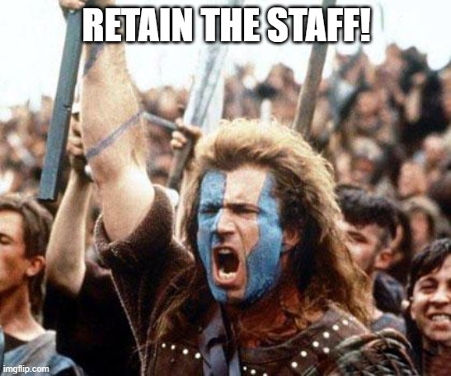
Burnout
more than just a bad day!
Seth Petry-Johnson
Notes:
Travel forward in time to 2021, and things aren’t exactly “improving”. I’m still barely getting dressed for work and binge eating ice cream in bed every night, although at least I was getting less embarrassed to admit it.
I think a lot of people were feeling similarly worn down in that time.
At work, my company was feeling the impact of all that stress. People were grumpy, productivity was down, and we started to worry about turnover.
One of our teams had an employee leave, which increased the workload on those that were left. The people that were left out were already stressed out themselves, and the increased workload started to make them leave too. It was clear that we were on the brink of what could become a cascading turnover crisis.

Slide 5
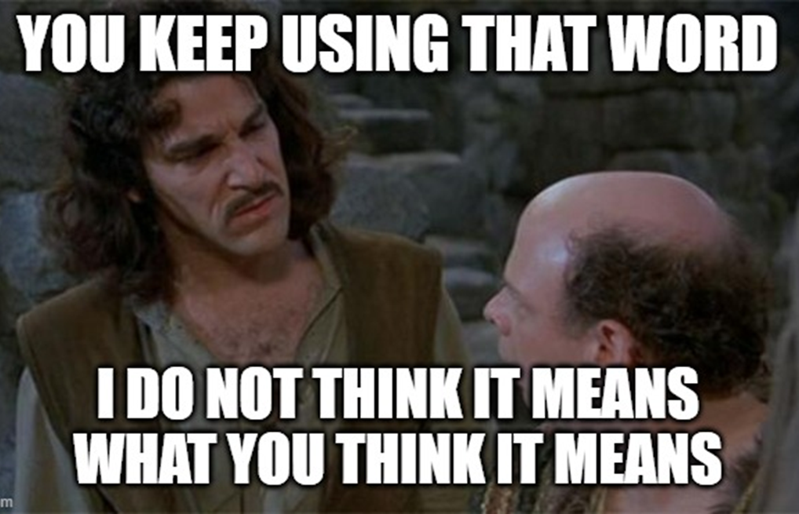
Burnout
more than just a bad day!
Seth Petry-Johnson
Notes:
In response, we set a major organizational goal for 2021 to stop the attrition and to retain our staff.
This was a key focus at all layers of management, so we started investigating morale on all of our teams, not just the one that was approaching a crisis.
And as we talked to people, we heard a lot of people mention “burnout”.

Slide 6
Burnout
more than just a bad day!
Seth Petry-Johnson
Today’s agenda
Understanding burnout
Diagnosing and measuring burnout
Treating / managing burnout
Notes:
But when we tried to drill in, no one quite explained or thought about burnout in quite the same way.
It was a bit like the Supreme Court and pornography; everyone was certain they could identify burnout when they saw it or were experiencing it, but couldn’t define it terms that helped us create an action plan to address it.
So, I decided to do some research into burnout. I wanted to know more about what caused it, whether there was any standard way of measuring it, and what we could do to recover from it.

Slide 7

Burnout
more than just a bad day!
Seth Petry-Johnson
Employed Americans w/ no ideas for reducing burnout
1 in 10
Today’s agenda
Understanding burnout
Diagnosing and measuring burnout
Treating / managing burnout
Notes:
And that brings us to today’s agenda.
This session is a summary of what I learned from that research and the act of applying to our teams.
I’ll start with a brief summary of the research I did into what burnout is and what causes it.
I’ll introduce a tool I used to measure burnout and show you how to roll it out on your teams as well.
And finally we’ll talk about how you can use those burnout measurements to more effectively treat or manage the burnout your staff is feeling.

Slide 8
Burnout
more than just a bad day!
Seth Petry-Johnson
Understanding burnout
Employed Americans reporting worker burnout
Today’s agenda
Diagnosing and measuring burnout
76%
Treating / managing burnout
Notes:
Let’s start with the obligatory statistics that seem like a requirement for this kind of session.
One study in 2020 found that 76% of American workers were reporting symptoms of burnout.
https://springhealth.com/wp-content/uploads/2020/12/Spring-Health-Burnout-Nation.pdf

Slide 9
Burnout
more than just a bad day!
Seth Petry-Johnson
Understanding burnout
Employed Americans reporting complete burnout
9%
Notes:
The same study found that 9% of US workers were reporting complete burnout. They were suffering so much that it was having debilitating impacts on both their careers and their health.

Slide 10

Burnout
more than just a bad day!
Seth Petry-Johnson
Understanding burnout
Employed Americans w/ no ideas for reducing burnout
1 in 10
$190 BILLION in healthcare spending due to burnout
Notes:
And 1 in 10 workers reported having no ideas at all about how they might reduce burnout for themselves or others.
If you fall into this category right now, then this session is absolutely for you.

Slide 11
Burnout
more than just a bad day!
Seth Petry-Johnson
Understanding burnout
Employed Americans w/ no ideas for reducing burnout
1 in 10
$190 BILLION in healthcare spending due to burnout
Notes:
All of this stuff has a very real cost;
The Harvard Business Review estimates that the annual cost of healthcare spending due to workplace burnout is between 125 and 190 billion dollars.
http://hbswk.hbs.edu/item/national-health-costs-could-decrease-if-managers-reduce-work-stress

Slide 12
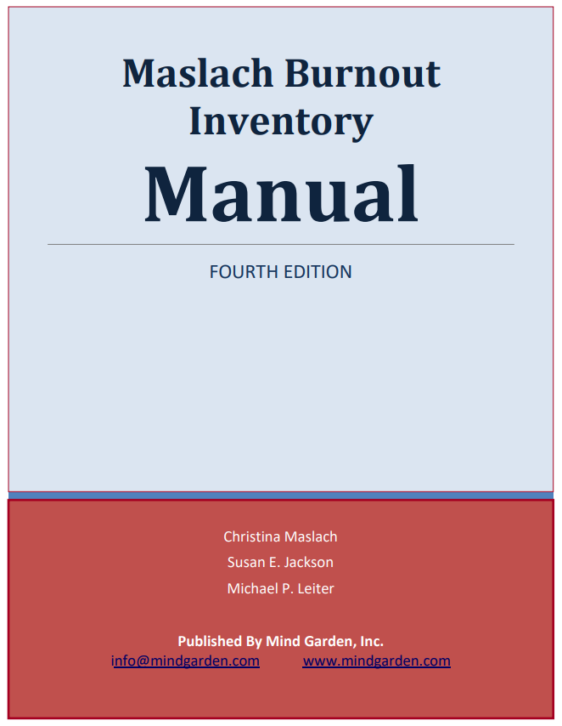
Burnout
more than just a bad day!
Seth Petry-Johnson
Understanding burnout
Burned out employees are 2.6 times more likely to quit
Notes:
Finally, a Gallup study found that burned-out employees are 2.6 times more likely to seek a new job.
On average, replacing a full-time employee can cost of $15,000, so burnout-driven turnover can definitely affect your bottom line.
I’m assuming that after living through the last couple of years you don’t need me to convince you that burnout is a problem.
I’d rather talk about what causes burnout, and how it affects us if it goes untreated.
I referenced three different publications during this project.
http://hbswk.hbs.edu/item/national-health-costs-could-decrease-if-managers-reduce-work-stress

Slide 13
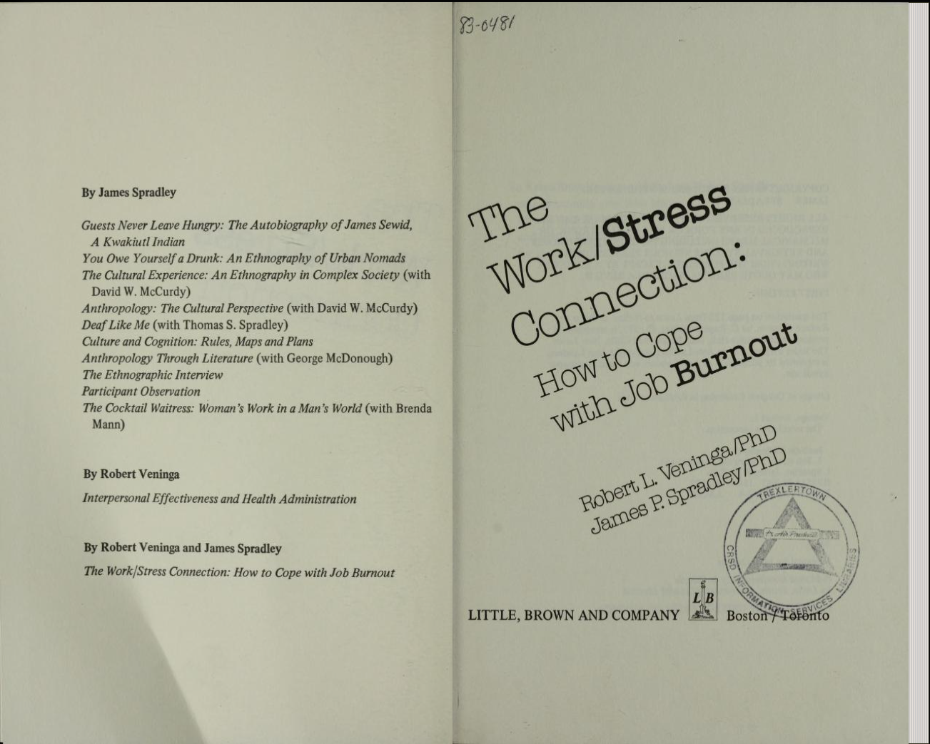
Burnout
more than just a bad day!
Seth Petry-Johnson
Understanding burnout
Burned out employees are 2.6 times more likely to quit
Notes:
The first is the Maslach Burnout Inventory, which was first published in 1981.
That seems like a long time ago, but the 80s were basically the golden years for burnout research. A lot of what we know about burnout comes from that era.

Slide 14
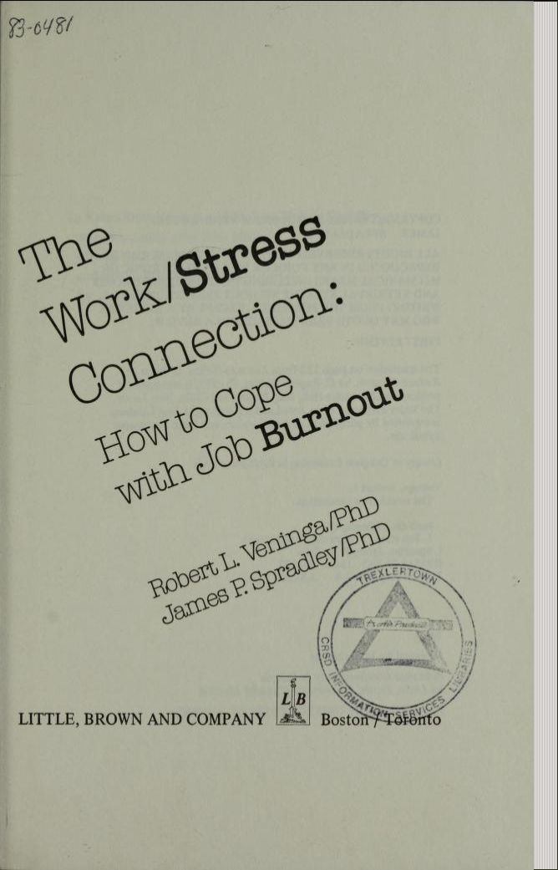
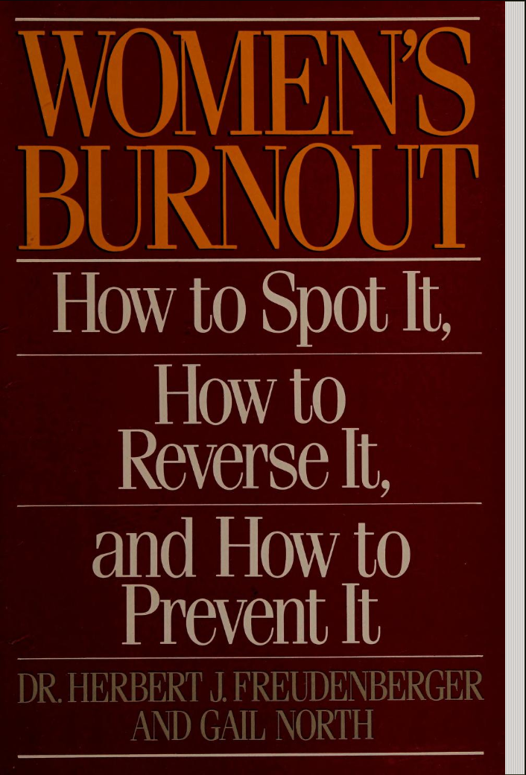
Burnout
more than just a bad day!
Seth Petry-Johnson
Understanding burnout
Notes:
The second resource I used was also published in 1981.
This book, the Work/Stress connection by Robert Veninga and James Spradley, is still considered one of the preeminent works on burnout; if you go home and do a web search right now, and you look at web articles published in the last year or two, many of them are based on the burnout model and research in this book.

Slide 15
Burnout
more than just a bad day!
Seth Petry-Johnson
Understanding burnout
Notes:
Lastly, I read a little bit of Women’s Burnout by Herbert Fruedenberger and Gail North, which came out in ‘85. Like I said the 80s were a hoppin’ time for burnout research.
Even though this book was ostensibly written about women’s burnout, it is still widely referenced today and is the basis for a lot of non-gender-specific research.

Slide 16
Burnout
more than just a bad day!
Seth Petry-Johnson
Understanding burnout
Burnout is a syndrome,
not a specific diagnosis
Notes:
These publications all approach the topic a little bit differently, but they generally agree that burnout is syndrome, not a specific diagnosis.

Slide 17
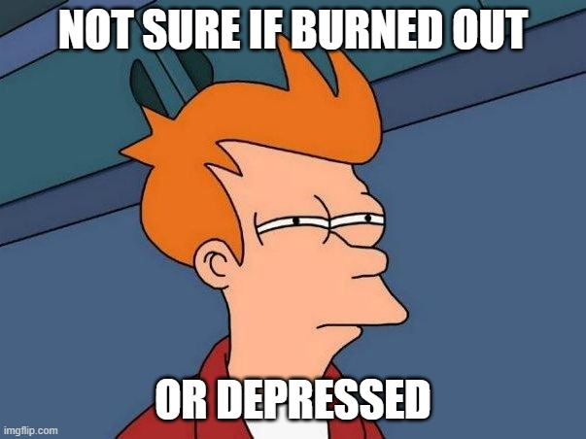
Burnout
more than just a bad day!
Seth Petry-Johnson
Understanding burnout
Burnout is a syndrome,
not a specific diagnosis
A syndrome is a group of symptoms that consistently occur together
Veninga and Spradley 5 stages
Notes:
A syndrome is just a group of symptoms that tend to occur together.
There’s no burnout bacteria or virus and there’s no blood test that you can take to determine if you’re burnt out.
Any sort of “diagnosis” is based on the collection of symptoms that you report experiencing.
These symptoms can include a significant lack of energy, loss of motivation, withdrawing from relationships, poor performance at work, and anger management issues.

Slide 18

Burnout
more than just a bad day!
Seth Petry-Johnson
Understanding burnout
Burnout is a syndrome,
not a specific diagnosis
A syndrome is a group of symptoms that consistently occur together
Veninga and Spradley 5 stages
Notes:
Many of those symptoms also accompany depression, and it can be hard to figure out if burnout has progressed into a depression, or if a depression is causing or exacerbating burnout.
Depression can be caused by a lot of different things, including chemical imbalances in your brain.
I’m just a random guy speaking at a computer conference, I am not qualified to give medical advice about depression.
But I can tell you that taking care of your mental health is a best practice, and you’ll be better equipped to handle burnout if your serotonin levels are balanced correctly, so it’s never a bad idea to check in with a doctor if you’re feeling those symptoms.

Slide 19
Burnout
more than just a bad day!
Seth Petry-Johnson
Understanding burnout
Burnout is a syndrome,
not a specific diagnosis
A syndrome is a group of symptoms that consistently occur together
Veninga and Spradley 5 stages
Burnout symptoms accompany chronic unmanaged stress
in the workplace
Notes:
Speaking about burnout specifically, all three of these publications agree that burnout is a response to chronic, unmanaged stress in the workplace.
That “workplace” distinction is important; my research and this session focus entirely on burnout at work. We’re not talking about how my daughter gets “burned out on chicken” when I cook it four nights in a row, or how I burned out on superhero movies after Avengers Endgame, or how you get worn down by caring for an aging parent or whatever.
Burnout at home surely exists, but for today I’m talking specifically about how stress you experience at work affects your ability to do your job and interact with your coworkers.

Slide 20
Burnout
more than just a bad day!
Seth Petry-Johnson
Understanding burnout
Burnout is a syndrome,
not a specific diagnosis
How is burnout modeled?
Veninga and Spradley 5 stages
Burnout symptoms accompany chronic unmanaged stress
in the workplace
Notes:
These publications differ in how they model the stress response that we label as “burnout”.
Comparing those models is interesting because it helps us understand how burnout gets worse over time, and that gives us insight we can use to treat it.
Let’s start with Veninga and Spradley, whose book lays out a 5-stage model of burnout.

Slide 21


Burnout
more than just a bad day!
Seth Petry-Johnson
Veninga and Spradley 5 stages of workplace burnout
Honeymoon
High job satisfaction
Commitment / energy / creativity
Stress feels like “good stress”
Notes:
This model begins with the “Honeymoon Phase”. Most workers begin their jobs with enthusiasm and a desire to make it work out, and it’s exciting at the start when you’re meeting new people, learning new things, and demonstrating your competence to your new peers.
During this phase, stress often feels like “good stress”, in that it gives meaning to the work and adds to our sense of fulfillment. Maybe you’re working against a deadline, but you were hired specifically to help the team hit that deadline and so the time pressure is, in a way, validating your existence on the team.
If you’re well suited to your job, this phase can go on for a long time, well beyond when you’re considered “new”. Some people can sail along here for years, seemingly immune to the effects of that stress.
But for most people, there are two things that happen during this phase that contribute to burnout.

Slide 22
Burnout
more than just a bad day!
Seth Petry-Johnson
Veninga and Spradley 5 stages of workplace burnout
Honeymoon
High job satisfaction
Commitment / energy / creativity
Stress feels like “good stress” but is it really?
Notes:
The first thing is that, even if the stress feels like good stress, it still causes a stress response.
Millions of years ago, nearly everything that caused stress could kill us, so we evolved a highly automated “fight or flight” response.
When exposed to stress, the human brain instantly and automatically floods the body with signals and hormones that cause a sharp increase in energy consumption, readying muscles to fight or flee. In either case, there’s going to be some sort of major muscular activity that needs to take place in a fairly short period of time.

Slide 23
Burnout
more than just a bad day!
Seth Petry-Johnson
Veninga and Spradley 5 stages of workplace burnout
Honeymoon
High job satisfaction
Commitment / energy / creativity
Stress feels like “good stress” but still uses up adaptation energy
Finite resource used to fuel the “fight or flight” response caused by stress
Notes:
Early research identified this concept of “adaptation energy”, which is the stuff the body consumes to power that fight or flight response.
This is a finite resource, so when stress continues for a prolonged period, we can start to run out of this energy.

Slide 24
Burnout
more than just a bad day!
Seth Petry-Johnson
Veninga and Spradley 5 stages of workplace burnout
Honeymoon
High job satisfaction
Commitment / energy / creativity
Stress feels like “good stress” but still uses up adaptation energy
Burnout occurs when adaptation energy runs out
Notes:
Veninga and Spradley believe that this fight or flight response has become obsolete, and that what we experience as burnout is the body running out of its adaptation energy reserves.
A primitive human’s stress response only had to sustain them for a short period of time: either a quick battle with the animal that will be dinner, or quickly running away from the animal that would make you its dinner. In either case, the stress event doesn’t last super long.
But I’ve been on stressful teams, or on projects that worked under tight deadlines for months or even years. This book argues that fight or flight is just not appropriate at handling low-grade, constant stress over a long period and without any acute activity to discharge the tension.

Slide 25
Burnout
more than just a bad day!
Seth Petry-Johnson
Veninga and Spradley 5 stages of workplace burnout
Honeymoon
High job satisfaction
Commitment / energy / creativity
Stress feels like “good stress” but still uses up adaptation energy
Develop ineffective coping strategies
Notes:
The second thing that happens during the honeymoon phase is that we start to develop coping strategies for this constant workplace stress.
If those coping strategies aren’t effective at restoring that adaptation energy, then burnout starts to set in and we progress to phase 2.

Slide 26

Burnout
more than just a bad day!
Seth Petry-Johnson
Veninga and Spradley 5 stages of workplace burnout
Fuel Shortage
Honeymoon
Begin to overdraw adaptation energy
Vague feeling of loss
“Balancing act”
Notes:
The “Fuel Shortage” phase is when you’re burning more of that adaptation energy than you’re restoring.
This can happen slowly, but over time your enthusiasm for the job starts to waver.
This is sometimes referred to as a “balancing act” because people in this stage are constantly trying to balance between fatigue and confusion on one hand and enthusiasm and control on the other, sort of like they’re on a tightrope with more and more stuff being handed to them.

Slide 27
Burnout
more than just a bad day!
Seth Petry-Johnson
Veninga and Spradley 5 stages of workplace burnout
Fuel Shortage
Honeymoon
Begin to overdraw adaptation energy
Vague feeling of loss
“Balancing act”
Most frequent burnout symptoms begin to appear: dissatisfaction, inefficiency, fatigue, sleep disturbance, escape activities
Notes:
Once those energy reserves are depleted far enough, the most frequent symptoms of job burnout make their appearance. You are dissatisfied or ineffective at work
Job Dissatisfaction
Inefficiency at work
Fatigue
Sleep Disturbances
Escape activities
This is when you start feeling tired all the time and might see an increase in drug or alcohol use, binge watching TV, playing excessive amounts of video games, etc.
Those things are basically an attempt by your body and brain to try and replenish your adaptation energy.

Slide 28

Burnout
more than just a bad day!
Seth Petry-Johnson
Veninga and Spradley 5 stages of workplace burnout
Fuel Shortage
Chronic Symptoms
Honeymoon
Chronic exhaustion
Physical illness
Anger / depression
Notes:
Unfortunately, escape activities aren’t really that good at actually rejuvenating us, and if our energy reserves keep dropping we enter the third stage of burnout where the physical and psychological symptoms become more pronounced and severe.
This is where tiredness turns into chronic exhaustion and people begin to experience physical issues like headaches, stomach aches, and physical illness.

Slide 29
Burnout
more than just a bad day!
Seth Petry-Johnson
Veninga and Spradley 5 stages of workplace burnout
Fuel Shortage
Chronic Symptoms
Honeymoon
Chronic exhaustion
Physical illness
Anger / depression
Symptoms and time in each stage different for everyone
Notes:
In these first three stages, people not only have different symptoms but they travel through the stages in different ways.
Some people move through the stages rapidly, others will stay in one stage for years, and other people will move back and forth between stages. They’ll start out with enthusiasm, they’ll burn up their energy and develop chronic symptoms, then they’ll create coping strategies that help them recover and move back to an earlier stage before the cycle repeats.
Most people spend their working lives somewhere in this range.

Slide 30

Burnout
more than just a bad day!
Seth Petry-Johnson
Veninga and Spradley 5 stages of workplace burnout
Symptoms become critical
Obsession w/ frustrations
Pessimism and self-doubt
“Escape mentality”
Fuel Shortage
Chronic Symptoms
Honeymoon
Crisis
Notes:
But if you have enough high risk factors going at the same time, they can push you into a burnout crisis.
Four significant changes mark this crisis phase:
Symptoms increase in intensity and number. Stomach aches turn into bleeding ulcers, headaches turn into migraines, and escape activities start to take over your life.
You become obsessed with your frustrations, complaining about things at work over and over again to the point that it’s all you want to talk about.
You become pessimistic and lose confidence in yourself
When the feelings get bad enough, you start looking for an escape hatch. People in this stage can make some very bad decisions in an attempt to get relief from the stress they are feeling.

Slide 31
Burnout
more than just a bad day!
Seth Petry-Johnson
Veninga and Spradley 5 stages of workplace burnout
Burnout transitions into significant and persistent physical or emotional problems
Fruedenberger’s 12 stages
Fuel Shortage
Chronic Symptoms
Hitting the Wall
Honeymoon
Crisis
← you can travel backwards through the phases!
Notes:
The last stage is called “hitting the wall” because things can get so bad that they literally stop you from continuing to work, for potentially years to come.
The researchers found that people in this stage had so totally used up their adaptation energy that they lost control of their lives and their careers. Some people were affected so profoundly that they never returned to work, ever.
The burnout had become so entwined with other problems like alcoholism, drug abuse, mental illness, heart disease, and anger management problems that it couldn’t be untangled and dealt with.

Slide 32
Burnout
more than just a bad day!
Seth Petry-Johnson
Veninga and Spradley 5 stages of workplace burnout
Fruedenberger’s 12 stages
Fuel Shortage
Chronic Symptoms
Hitting the Wall
Honeymoon
Crisis
← you can travel backwards through the phases!
Notes:
This last stage is pretty dark, but the good news is that it isn’t inevitable that things get that bad.
Yes, the modern workplace exposes us to constant stress, but we can learn to cope and recover into the earlier phases.
We’ll talk more about that in a little bit.

Slide 33
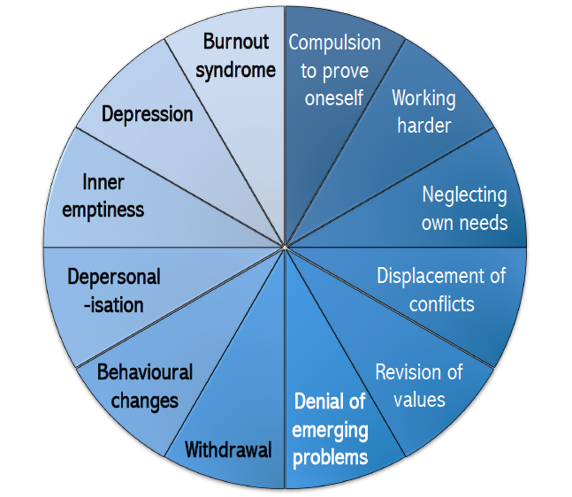
Burnout
more than just a bad day!
Seth Petry-Johnson
Veninga and Spradley 5 stages of workplace burnout
Fruedenberger’s 12 stages
Hitting the Wall
Honeymoon
→
Maslach Burnout Inventory 3 scales for measuring burnout
Notes:
Whereas Veninga and Spradley came up with that 5 stage model of burnout, Fruedenburger developed a 12 stage model in his book.
(click)
I’m not going to go through this in detail, but it’s largely consistent with the progression of the 5-stage model. It starts out with a compulsion to prove yourself, proceeds into a balancing act between engagement and disengagement, symptoms start to worsen, and then eventually turn into depression and complete burnout.
It’s a more detailed model, but it tells the same story as the 5-stage model.

Slide 34

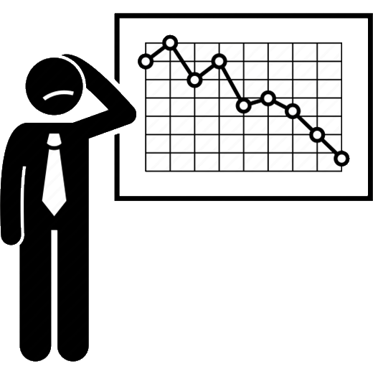
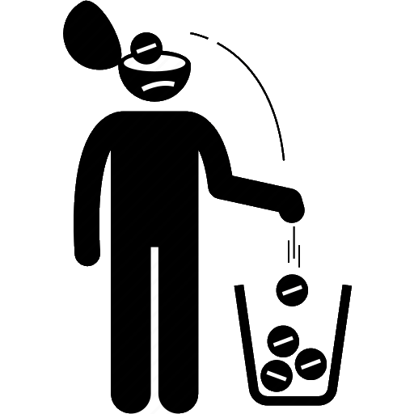
Burnout
more than just a bad day!
Seth Petry-Johnson
Veninga and Spradley 5 stages of workplace burnout
Maslach Burnout Inventory 3 scales for measuring burnout
Fruedenberger’s 12 stages
Hitting the Wall
Honeymoon
→
Lost energy
Lost enthusiasm
Lost confidence
Exhaustion
Professional Efficacy
Cynicism
Notes:
The third publication I used in this project was the Maslach Burnout Inventory, and it takes a different approach.
Instead of modeling burnout as a linear progression through a set of phases, the MBI models burnout as three independent things:

Slide 35
Burnout
more than just a bad day!
Seth Petry-Johnson
Veninga and Spradley 5 stages of workplace burnout
Maslach Burnout Inventory 3 scales for measuring burnout
Fruedenberger’s 12 stages
Hitting the Wall
Honeymoon
→
Lost energy
Lost enthusiasm
Lost confidence
Exhaustion
Professional Efficacy
Cynicism
Notes:
Lost energy for work, lost enthusiasm about the job, and lost confidence in your ability to do the job well.
To assess those things, the MBI measures the frequency of three different types of feelings that contribute to burnout.

Slide 36
Burnout
more than just a bad day!
Seth Petry-Johnson
Maslach Burnout Inventory 3 scales for measuring burnout
Feelings related to work, not symptoms
Professional Efficacy
Exhaustion
Cynicism
How frequently we feel used up by our work
Notes:
Those feelings are exhaustion, cynicism, and professional efficacy.
(click)
Again, these are feelings that can be measured, not symptoms of burnout.
The MBI tracks how frequently we have these three types of thoughts.

Slide 37
Burnout
more than just a bad day!
Seth Petry-Johnson
Maslach Burnout Inventory 3 scales for measuring burnout
Measured as a frequency
Professional Efficacy
Exhaustion
Cynicism
How frequently we feel used up by our work
How frequently we feel disengaged from our work
Notes:
The Exhaustion scale measures how frequently we feel exhausted by our job or role.

Slide 38
Burnout
more than just a bad day!
Seth Petry-Johnson
Maslach Burnout Inventory 3 scales for measuring burnout
Measured as a frequency
Professional Efficacy
Exhaustion
Cynicism
How frequently we feel used up by our work
How frequently we feel disengaged from our work
How frequently we feel effective/competent at work
Notes:
The Cynicism scale measures how frequently we feel disengaged from our work, perhaps because we don’t think the work is important, or because we don’t enjoy what we’re doing.

Slide 39
Burnout
more than just a bad day!
Seth Petry-Johnson
Maslach Burnout Inventory 3 scales for measuring burnout
Measured as a frequency
Professional Efficacy
Exhaustion
Cynicism
How frequently we feel used up by our work
How frequently we feel disengaged from our work
How frequently we feel effective/competent at work
Notes:
The Professional Efficacy scale measures how frequently we feel effective or competent at work.
Each of these feelings is independent of the others, and the frequency with which we have each type of feeling affects burnout differently. We’ll come back to this in a minute.

Slide 40


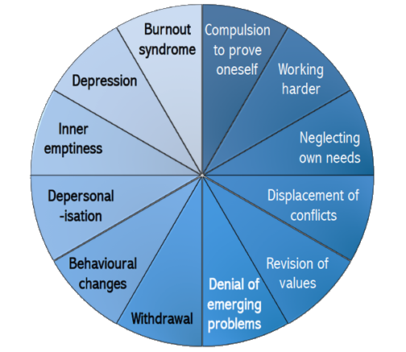
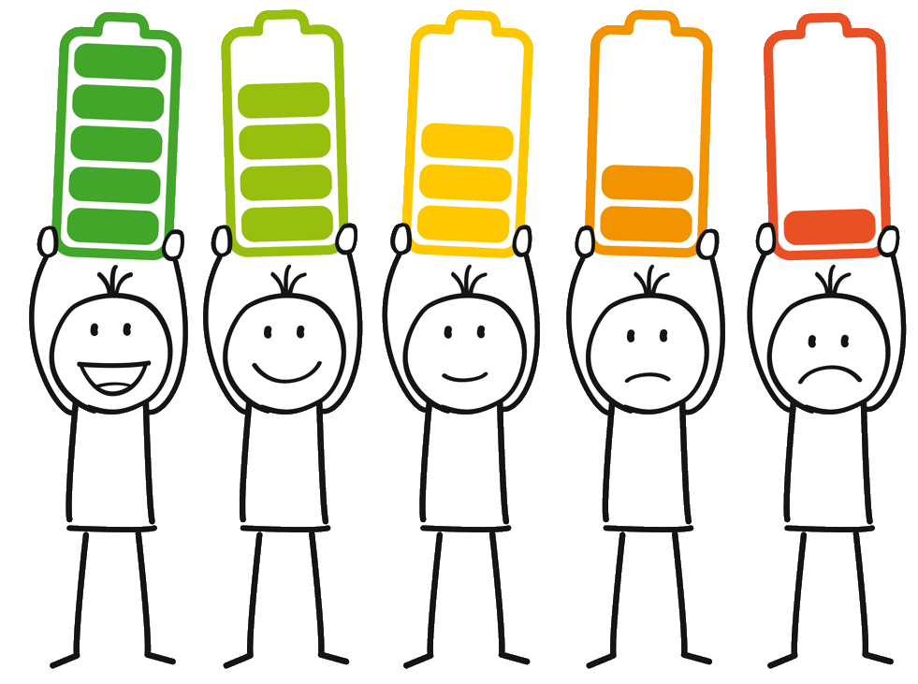
Burnout
more than just a bad day!
Seth Petry-Johnson
3 models of burnout
Low Professional Efficacy
Exhaustion
3 separate feelings
Progressively worsening symptoms
How frequently we feel used up by our work
How frequently we feel effective/competent at work
Cynicism
How frequently we feel disengaged from our work
Notes:
When it comes to actually measuring burnout, I think the Maslach Burnout Inventory is more useful than the other two models.
(click)
Viewing burnout as a progression through worsening symptoms is very helpful at qualitatively understanding the syndrome, but it doesn’t lend itself to measuring burnout.
(click)
By measuring frequency of feelings on a scale, the MBI can give us a more detailed model of how a person is responding to stress at work, and we can use that model to decide how to treat the burnout.

Slide 41
Burnout
more than just a bad day!
Seth Petry-Johnson
Measuring burnout
Progressively worsening symptoms
How frequently we feel used up by our work
Notes:
So let’s talk about how to use the MBI to measure and evaluate burnout.
This is the tool that I used in my own organization to evaluate burnout, so I have first-hand experience with it.

Slide 42
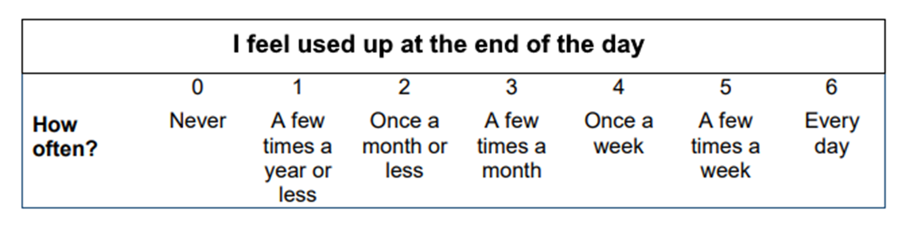
Burnout
more than just a bad day!
Seth Petry-Johnson
Measuring burnout
Burnout Inventory
Areas of Worklife Survey
Measures 3 types of feelings to
provide a burnout “score”
Suggests reasons for burnout due to mismatch w/ key aspects of job/role
Notes:
There are actually two related tools that I want to talk about.
(click)
The Maslach Burnout Inventory, or MBI, is used to measure burnout itself.
(click)
The Areas of Workflife Survey, or AWS, is used to measure alignment with a job or role. By identifying areas of mismatch, it can be used to identify reasons for the level of burnout someone is experiencing.

Slide 43
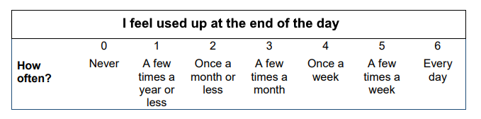
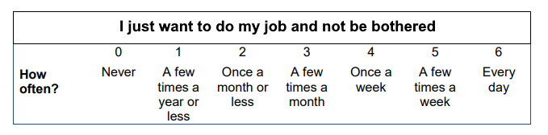
Burnout
more than just a bad day!
Seth Petry-Johnson
Measuring burnout
Areas of Worklife Survey
Suggests reasons for burnout due to mismatch w/ key aspects of job/role
Burnout Inventory
Measures 3 types of feelings to provide a burnout “score”
Notes:
We’ll talk about the MBI first.
The MBI is a survey that people take. It consists of 16 questions like this, which are called Likert Scale questions; they ask you to identify how frequently you experience a given feeling in your workplace.
For instance, one question asks you to indicate how frequently you feel “used up” at the end of the day.

Slide 44
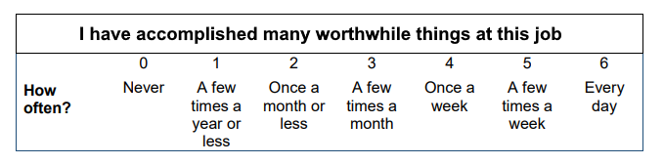
Burnout
more than just a bad day!
Seth Petry-Johnson
Measuring burnout
Burnout Inventory
Measures 3 types of feelings to provide a burnout “score”
Notes:
Another question asks you to identify how frequently you feel like you just want to be left alone to get your job done…

Slide 45
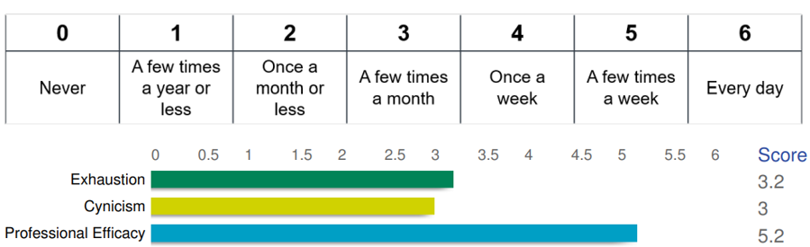
Burnout
more than just a bad day!
Seth Petry-Johnson
Measuring burnout
Exhaustion
Cynicism
Professional Efficacy
Burnout Inventory
Measures 3 types of feelings to provide a burnout “score”
Notes:
… and another question asks you to identify how frequently you feel like you are accomplishing worthwhile things in your job.

Slide 46
Burnout
more than just a bad day!
Seth Petry-Johnson
Measuring burnout
Exhaustion
Cynicism
Burnout Inventory
Measures 3 types of feelings to provide a burnout “score”
Professional Efficacy
Notes:
Each question in the MBI is linked to one of the three feelings that it’s measuring: Exhaustion, Cynicism, and Professional Efficacy.

Slide 47
Burnout
more than just a bad day!
Seth Petry-Johnson
Measuring burnout
Exhaustion
Cynicism
Burnout Inventory
Measures 3 types of feelings to provide a burnout “score”
Professional Efficacy
Notes:
Based on your answers, the survey produces a mathematical score for each of the three scales that indicates how frequently you experience that feeling at work.
These are my results the last time I took the survey.

Slide 48
Burnout
more than just a bad day!
Seth Petry-Johnson
Measuring burnout
Burnout Inventory
Measures 3 types of feelings to provide a burnout “score”
For Exhaustion and Cynicism,
higher numbers indicate burnout
Notes:
On the Exhaustion and Cynicism scales, higher numbers indicate higher levels of burnout.
If you frequently feel used up and disengaged from your job, you’re more likely suffering burnout than if you rarely feel used up and disengaged

Slide 49
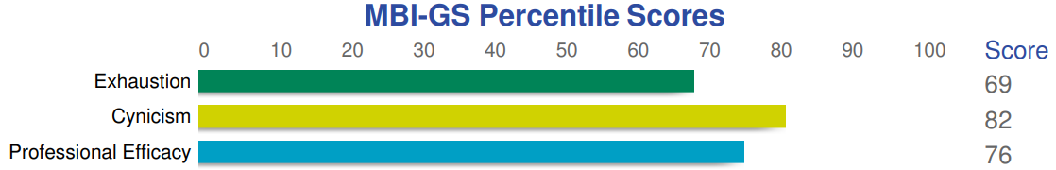
Burnout
more than just a bad day!
Seth Petry-Johnson
Measuring burnout
Burnout Inventory
Measures 3 types of feelings to provide a burnout “score”
For Professional Efficacy,
lower numbers indicate burnout
Notes:
It’s the opposite for the Professional Efficacy scale.
This tracks how frequently you feel effective and competent at work, so lower numbers indicate burnout.
If you rarely feel effective at work you are more likely suffering from burnout than if you feel competent on a daily basis.

Slide 50
Burnout
more than just a bad day!
Seth Petry-Johnson
Measuring burnout
Burnout Inventory
Measures 3 types of feelings to provide a burnout “score”
Notes:
These numbers are kind of hard to evaluate in a vacuum.
My report says I feel worn out by my job a few times a month, but how common is that? What’s the threshold between being burnt out and just having a bad day?

Slide 51
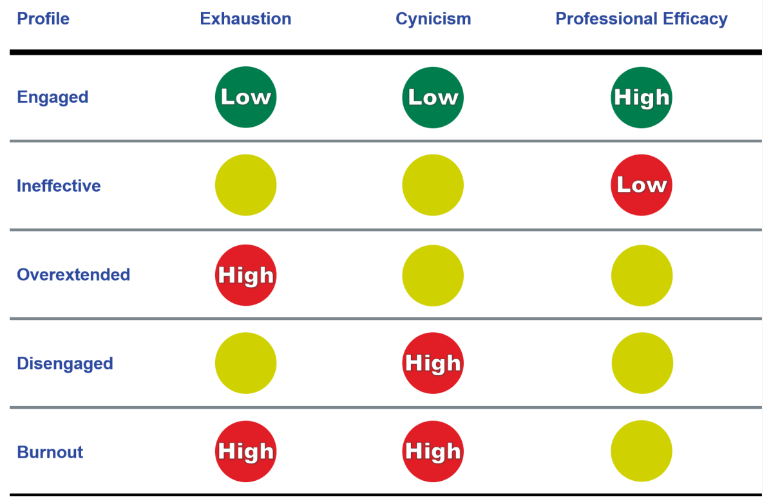
Burnout
more than just a bad day!
Seth Petry-Johnson
Measuring burnout
Percentage of 22,000 people experiencing this feeling with less frequency than respondent
Burnout Inventory
Measures 3 types of feelings to provide a burnout “score”
Notes:
To put those numbers in context, the survey compares your results with a database of 22,000 other people and gives you a percentile score that tells you what percentage of those people experienced each feeling less frequently than you did.

Slide 52
Burnout
more than just a bad day!
Seth Petry-Johnson
Measuring burnout
I felt exhaustion more frequently than 69%
of those 22,000 people
Burnout Inventory
Measures 3 types of feelings to provide a burnout “score”
Notes:
In other words, I indicated feeling exhaustion more frequently than 69% of the 22,000 people in the dataset.
I’m basically in the top third, which may be a warning sign.

Slide 53
Burnout
more than just a bad day!
Seth Petry-Johnson
Measuring burnout
I felt cynicism more frequently than 82%
of those 22,000 people
Burnout Inventory
Measures 3 types of feelings to provide a burnout “score”
Notes:
I indicated feelings of disengagement from my work more frequently than 82% of those people, so I’m in the top 18% which is definitely a warning sign.

Slide 54
Burnout
more than just a bad day!
Seth Petry-Johnson
Measuring burnout
I felt effective at work more frequently than 76%
of those 22,000 people
Burnout Inventory
Remember, for efficacy higher numbers reduce burnout, so this is a good result for me
Measures 3 types of feelings to provide a burnout “score”
Notes:
But I also reported feeling effective at work more frequently than 76% of the dataset.
(click)
Remember that efficacy is the opposite of the other two scales, and feeling effective at one’s job can reduce burnout. So this third score is a good sign for me.

Slide 55
Burnout
more than just a bad day!
Seth Petry-Johnson
Measuring burnout
How well do these scores reflect my actual feelings at work?
Burnout Inventory
Measures 3 types of feelings to provide a burnout “score”
How frequently we feel used up by our work
Notes:
Before we go on, let’s pause for a minute and compare my survey results with what I was actually feeling at work.
Surprisingly, even though there were only 16 questions in the survey, I think the results accurately capture my experience.
I’ve been at my company for over 14 years, and in that time I’ve gone from a mid-level programmer to the director of the entire product team. Along that way I’ve picked up a number of roles and responsibilities that I don’t love doing, but that really need done and for which there’s no one else to do them.
People management is a good example; our programmers, QA staff, and UI/UX designer all report to me. I’m responsible for approving their PTO, coaching them through weekly 1-on-1s, developing their skills and managing their careers, and determining their salaries. I don’t really enjoy any of that, and it takes me away from technical work that I do enjoy. But we’re a small company and there just isn’t anyone else that has the capacity or the willingness to do it, so I do it.
The tension between doing the parts of my job that need to get done and the parts of my job that I truly enjoy doing is evident in these scores.

Slide 56
Burnout
more than just a bad day!
Seth Petry-Johnson
Measuring burnout
Burnout Inventory
Measures 3 types of feelings to provide a burnout “score”
How frequently we feel used up by our work
Notes:
On the exhaustion side, my energy levels have generally not rebounded to their pre-COVID levels. I can get through the day, I can get my work done, I can keep my kids alive, and I can occasionally summon the motivation to exercise, but I don’t have a lot of spare energy to put into new things.
That general feeling of low energy carries over into my job duties. I feel like I have to consciously expend energy to complete my people management and project management tasks, whereas the more technical work I do rejuvenates me. My score on this scale reflects the balance of those roles in my normal workday.

Slide 57
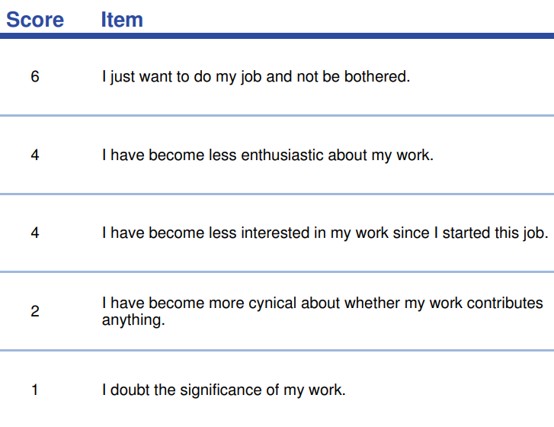
Burnout
more than just a bad day!
Seth Petry-Johnson
Measuring burnout
Burnout Inventory
Measures 3 types of feelings to provide a burnout “score”
How frequently we feel disengaged from our work
Notes:
My cynicism score is harder to unpack. It measures feelings of disengagement from work or people at work, but disengagement can have a number of different causes.

Slide 58
Burnout
more than just a bad day!
Seth Petry-Johnson
Measuring burnout
Burnout Inventory
Measures 3 types of feelings to provide a burnout “score”
How frequently we feel disengaged from our work
Notes:
One reason for feeling disengaged is doubting whether or not what you do actually matters.
This clearly isn’t an issue for me; I answered a “1” on this question, meaning “a few times a year or less”. Not a frequent occurrence.

Slide 59
Burnout
more than just a bad day!
Seth Petry-Johnson
Measuring burnout
Burnout Inventory
Measures 3 types of feelings to provide a burnout “score”
How frequently we feel disengaged from our work
Notes:
However, I have become less enthusiastic and interested in my work. I think this accurately reflects my ongoing transition from a developer and technical architect into a management role; it’s absolutely an important role, I’m just less excited about doing it than I was when I was a programmer.
When I was coding, I would often work extra hours not because anyone told me I needed to, but because I was just really engaged with whatever I was building. I’m less likely to voluntarily spend my free time on my people management duties.

Slide 60
Burnout
more than just a bad day!
Seth Petry-Johnson
Measuring burnout
Burnout Inventory
Measures 3 types of feelings to provide a burnout “score”
How frequently we feel disengaged from our work
Notes:
My highest score is on “I just want to do my job and not be bothered”, which I reported feeling nearly every day.
I’m naturally introverted and I like being in a quiet room and going deep into thought about something. Talking to people is a critical part of my leadership role, but that doesn’t mean I don’t wish I could just be left alone for bit chunks of time.

Slide 61
Burnout
more than just a bad day!
Seth Petry-Johnson
Measuring burnout
Burnout Inventory
Measures 3 types of feelings to provide a burnout “score”
How frequently we feel disengaged from our work
How frequently we feel effective/competent at work
Notes:
If you look at these scores together, they paint a picture of someone who knows their job is critically important, but who is struggling to remain enthusiastic and engaged about doing it.
And I think that’s a pretty fair picture of how I feel on any given day.
And if we stopped right there, these scores might indicate a moderately strong level of burnout, and you might start asking me why I’m not looking for a job I can be more excited about.

Slide 62
Burnout
more than just a bad day!
Seth Petry-Johnson
Measuring burnout
Burnout Inventory
Measures 3 types of feelings to provide a burnout “score”
How frequently we feel effective/competent at work
How frequently we feel disengaged from our work
Notes:
My professional efficacy scores can provide some insight. They paint a very different picture of someone who feels skilled, talented, and competent in their role.
I don’t claim to be a fantastic manager or leader, I have plenty of weak areas and things I’m not great at, but I have spent a lot of time deliberately learning how to be better. I’ve read books, listened to podcasts, and worked hard to compensate for the more introverted and left-brained parts of my personality. And I think my results in the role demonstrate that.
Additionally, I can clearly see the impact that I have on my organization in my role, and I know that I’m making a difference not only to the company, but in the day to day lives of the people that report to me. That feeling of making a difference and of playing a critical role is very fulfilling to me and counteracts some of the burnout I might otherwise be experiencing.

Slide 63
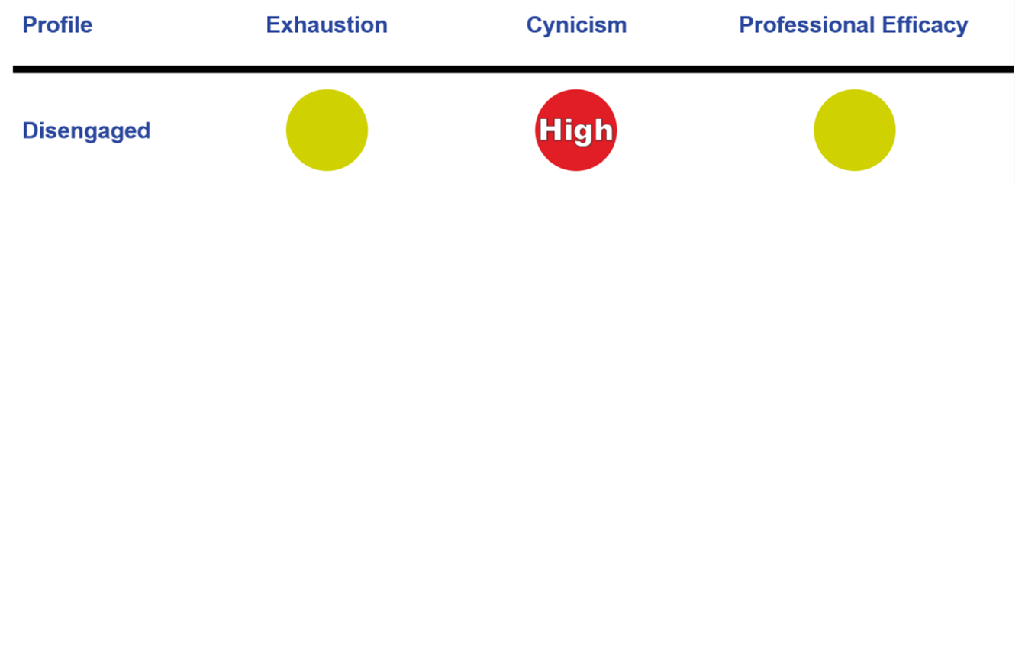

Burnout
more than just a bad day!
Seth Petry-Johnson
Measuring burnout
You can experience burnout even if you only score “bad” on a single scale!
Burnout Inventory
Measures 3 types of feelings to provide a burnout “score”
I’m not good at my job
I make a difference
Notes:
Just because I scored “good” on one of the scales doesn’t mean I’m not suffering from burnout; any one of these scales by itself can indicate a different type of burnout profile.
The MBI categorizes people into five different “profiles” that indicate the primary type of burnout someone is experiencing.

Slide 64
Burnout
more than just a bad day!
Seth Petry-Johnson
Measuring burnout
In the “Disengaged” profile,
Cynicism is the primary burnout factor
Burnout Inventory
Measures 3 types of feelings to provide a burnout “score”
Notes:
The profile associated with a report like mine is called “Disengaged”.
In this profile, Cynicism is the primary burnout factor. The other two scales are either not contributing, or have a moderate impact.
It’s really important to note that this is NOT saying that I AM disengaged, it’s just saying that my burnout profile is characterized by feelings that often accompany some form of disengagement. This report isn’t passing judgement on me and it’s not saying I’m doing poorly at my job.
It’s just providing a label that fits the pattern of my scores, which suggest that if my burnout continues in this way without treatment, it will likely manifest as increased disengagement from my job.

Slide 65
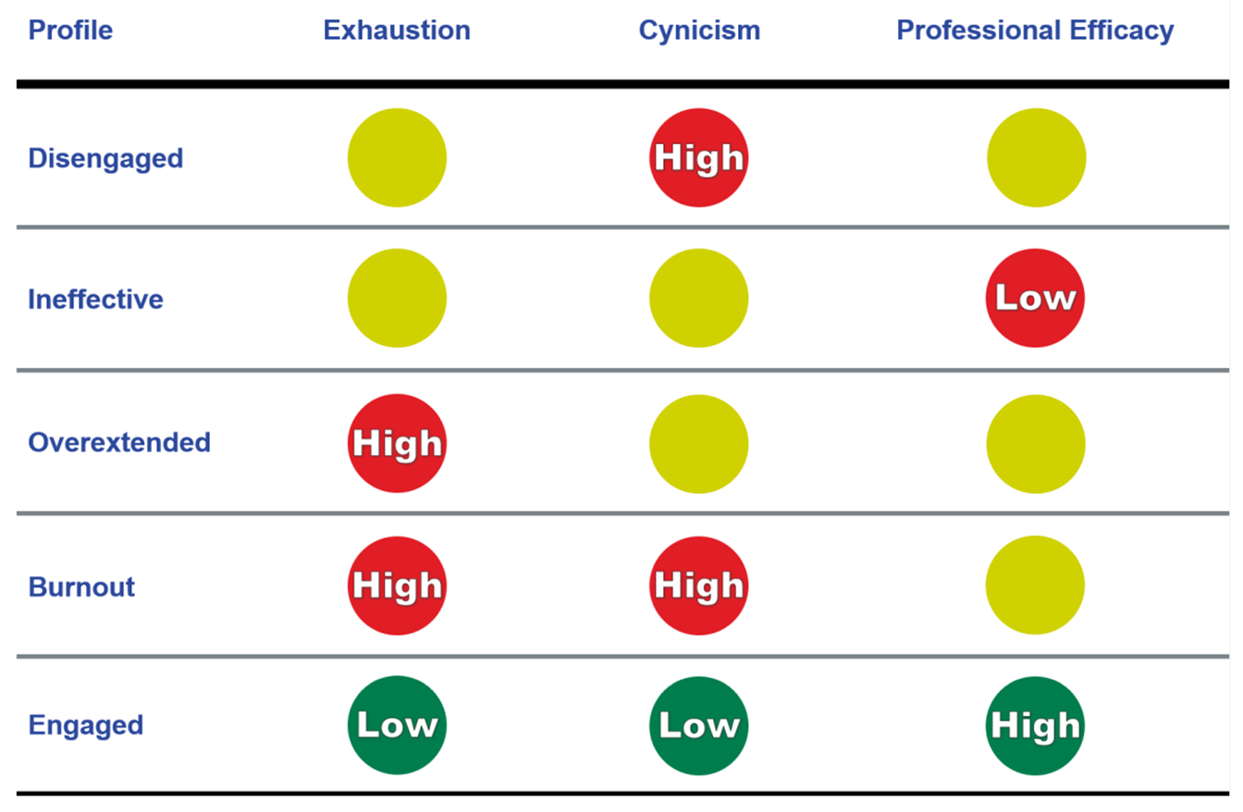
Burnout
more than just a bad day!
Seth Petry-Johnson
Measuring burnout
Low feelings of efficacy are primary driver
Burnout Inventory
Measures 3 types of feelings to provide a burnout “score”
Notes:
Similarly, the “Ineffective” profile isn’t saying that someone is actually ineffective at their job, it’s just saying that feeling ineffective is the primary driver of their burnout symptoms.

Slide 66
Burnout
more than just a bad day!
Seth Petry-Johnson
Measuring burnout
Exhaustion is primary driver
Burnout Inventory
Measures 3 types of feelings to provide a burnout “score”
Notes:
Likewise, the “Overextended” profile is characterized primarily by feelings of Exhaustion

Slide 67
Burnout
more than just a bad day!
Seth Petry-Johnson
Measuring burnout
Chronic Symptoms
Crisis
Two or more drivers of burnout
Burnout Inventory
Measures 3 types of feelings to provide a burnout “score”
Notes:
The “Burnout” profile is characterized by high frequencies of both exhaustion and cynicism. These people will usually also report feelings of low professional efficacy, but it’s the tiredness and disengagement that are primarily driving their burnout.
(click)
Left untreated, this is the sort of burnout that can progress into stages 4 and 5 of Veninga’s burnout model where chronic symptoms develop.

Slide 68
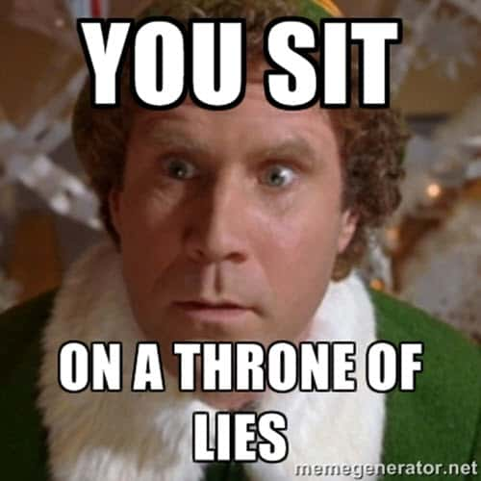
Burnout
more than just a bad day!
Seth Petry-Johnson
Measuring burnout
Chronic Symptoms
Crisis
Burnout Inventory
Measures 3 types of feelings to provide a burnout “score”
Notes:
And of course, some people aren’t burnt out at all. These lucky jerks show up energized and engaged every day. Good for them.

Slide 69

Burnout
more than just a bad day!
Seth Petry-Johnson
Measuring burnout
Burnout Inventory
Measures 3 types of feelings to provide a burnout “score”
Notes:
Let’s pause here for a moment.
I just spent a bunch of time explaining how a 16-question survey produces this highly insightful numerical model of how much burnout a person is feeling, and I totally understand if you’re sitting there feeling a little bit skeptical.
Like, can 5 questions really provide that accurate of a read on how disengaged I am from my job, given all of the factors that go into a role like mine?

Slide 70
Burnout
more than just a bad day!
Seth Petry-Johnson
Measuring burnout
Burnout Inventory
Measures 3 types of feelings to provide a burnout “score”
Notes:
It turns out that the MBI has been statistically proven to properly evaluate burnout.
There’s a whole field of scientific study called psychometrics that is used to develop and evaluate standardized tests. Psychometrics are used to design IQ tests, the SAT, certification exams, etc; you can’t use something like the SAT in college admissions without first proving that it actually works.
There are two main measures in psychometrics called “reliability” and “validity”.

Slide 71
Burnout
more than just a bad day!
Seth Petry-Johnson
Measuring burnout
Measures consistency of scores across multiple tests
The reliability of the three MBI scales exceeds recommended levels for research studies
The validity of the MBI has been demonstrated by numerous studies
Burnout Inventory
Measures 3 types of feelings to provide a burnout “score”
Areas of Worklife Survey
Suggests reasons for burnout due to mismatch w/ key aspects of job/role
Notes:
Reliability measures how consistent the results are across multiple takings of a test. If you repeat a reliable test under the same conditions, it will produce the same results; if the test produces random results, it’s not very reliable.
An analysis of over 84 published studies have confirmed that all three scales of the MBI exceed the recommended levels for surveys used in clinical research.

Slide 72
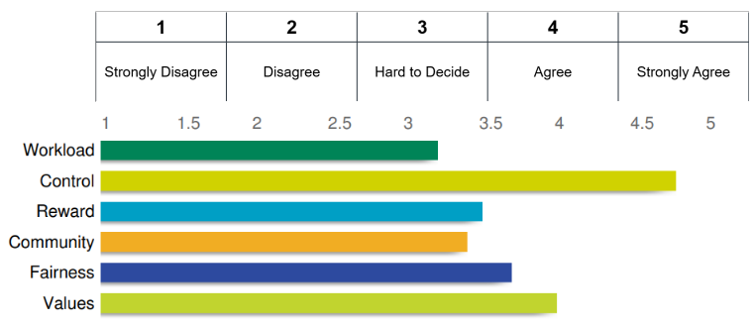
Burnout
more than just a bad day!
Seth Petry-Johnson
Measuring burnout
Measures consistency of scores across multiple tests
The reliability of the three MBI scales exceeds recommended levels for research studies
The validity of the MBI has been demonstrated by numerous studies
Burnout Inventory
Degree to which a test measures what it claims to measure
Measures 3 types of feelings to provide a burnout “score”
Areas of Worklife Survey
Suggests reasons for burnout due to mismatch w/ key aspects of job/role
Notes:
Validity is the degree to which the test measures the thing it claims to measure. In the case of the MBI, it’s how well the scores actually reflect a person’s feelings of burnout.
Again, multiple additional studies have established the validity of the MBI and that the scores correlate with other measures of burnout and disengagement.
This was sufficient to tell me that the MBI is a valid tool for use at work, and not some nonsense that a rando published on the internet.

Slide 73
The reliability of the three MBI scales exceeds recommended levels for research studies
The validity of the MBI has been demonstrated by numerous studies
Burnout Inventory
Measures 3 types of feelings to provide a burnout “score”
Burnout
more than just a bad day!
Seth Petry-Johnson
Measuring burnout
Areas of Worklife Survey
Suggests reasons for burnout due to mismatch w/ key aspects of job/role
Notes:
Let’s briefly talk about the Areas of Worklife Survey, which is a companion survey to the MBI.
Whereas the MBI measures burnout itself, the AWS measures the degree of fit, or the degree of mismatch, that you feel with 6 aspects of your organization: Workload, Control over how you do your job, Rewards and recognition, Community or the organization’s social environment, Fairness, and Values.
Mismatches in these areas can lead to burnout.

Slide 74
Burnout
more than just a bad day!
Seth Petry-Johnson
Measuring burnout
Areas of Worklife Survey
Suggests reasons for burnout due to mismatch w/ key aspects of job/role
“I do not have time to do the work that must be done”
Notes:
For instance, if you feel your workload is not manageable, and you don’t have time to develop professionally, that’s an obvious problem.

Slide 75
Burnout
more than just a bad day!
Seth Petry-Johnson
Measuring burnout
Areas of Worklife Survey
Suggests reasons for burnout due to mismatch w/ key aspects of job/role
“I receive recognition from others for my work”
Notes:
Reward measures how well you feel your organization provides social and financial recognition for your contributions. Feeling underpaid or undervalued is another common factor that can lead to burnout.

Slide 76
Burnout
more than just a bad day!
Seth Petry-Johnson
Measuring burnout
Areas of Worklife Survey
Suggests reasons for burnout due to mismatch w/ key aspects of job/role
“My values and the organization’s values are alike”
Notes:
It’s also important that you share a values system with your organization; if your organization cares only about the bottom line, and you care deeply about helping people, you’re obviously going to have a hard time staying engaged with that organization.
I don’t have enough time to go into the AWS in detail, but it’s a very similar survey and can provide even more detailed information about your staff if you choose to roll it out.

Slide 77
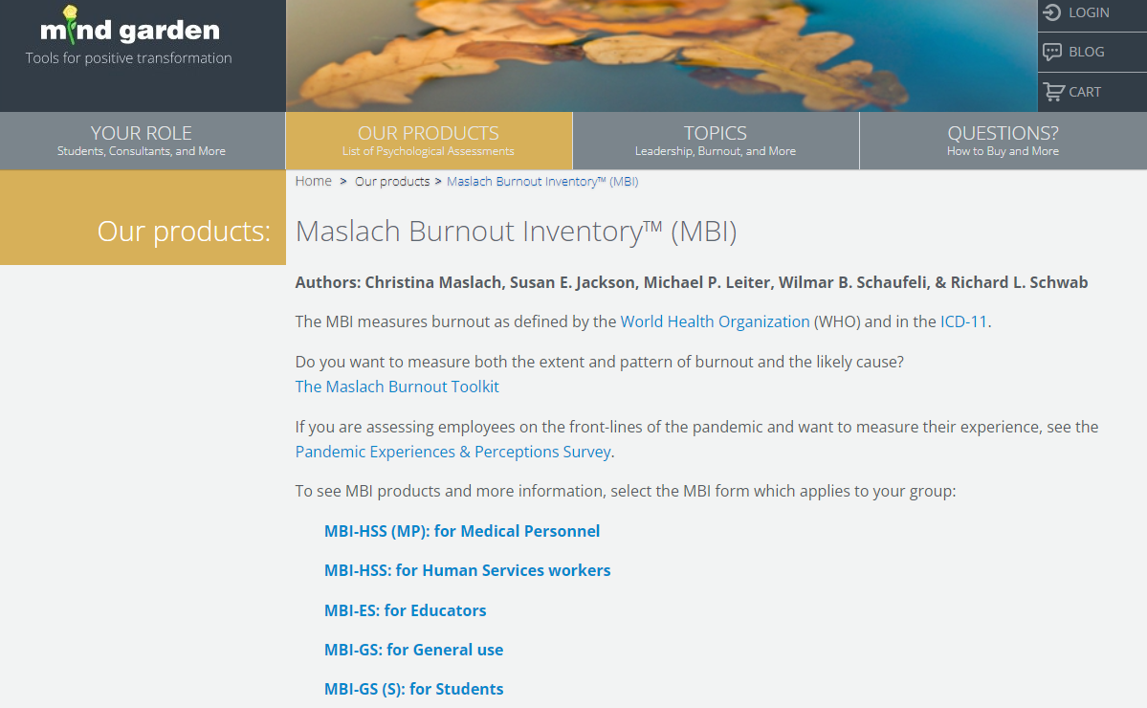
Burnout
more than just a bad day!
Seth Petry-Johnson
Rolling out the MBI to your team
Areas of Worklife Survey
Suggests reasons for burnout due to mismatch w/ key aspects of job/role
Notes:
Let’s talk about actually rolling these surveys out to your team and analyzing the results.
There are a couple of places where I can save you some head-scratching over some non-obvious options, and then there are some lessons learned I can share regarding the rollout I did in my company.

Slide 78
Burnout
more than just a bad day!
Seth Petry-Johnson
Rolling out the MBI to your team
MindGarden.com
Notes:
The MBI can be purchased from a website called MindGarden.com.
They sell a ton of different research instruments, but you can easily find the MBI by name.

Slide 79




Burnout
more than just a bad day!
Seth Petry-Johnson
Rolling out the MBI to your team
MindGarden.com
Burnout Inventory Manual
$50.00 – Only need 1
Transform Survey Hosting
$2.50 per person
Individual Report
$2.50 per person
Group Report
$200 per report
Notes:
The first thing that was non-obvious about this is that there are multiple different versions of the MBI. Some are designed for specific occupations, but the one you want to get is the MBI-GS for general use.
The occupation-specific ones have job-specific language that is only appropriate for people in those careers.

Slide 80
Burnout
more than just a bad day!
Seth Petry-Johnson
Rolling out the MBI to your team
Burnout Inventory Manual
$50.00 – Only need 1
Transform Survey Hosting
$2.50 per person
Individual Report
$2.50 per person
Group Report
$200 per report
MindGarden.com
Notes:
Figuring out how to actually buy the survey was a bit confusing at first because they offer a large number of things you can purchase, without clear guidance as to how they all work together.

Slide 81
Burnout
more than just a bad day!
Seth Petry-Johnson
Rolling out the MBI to your team
Burnout Inventory Manual
$50.00 – Only need 1
Required
Transform Survey Hosting
$2.50 per person
Individual Report
$2.50 per person
Group Report
$200 per report
MindGarden.com
Notes:
The simple explanation is that you should start by purchasing one copy of the “manual”, which provides instructions for delivering the survey.
You should also purchase one “Transform Survey Hosting” item per person that will be taking it. The term “transform” confused me at first, but I think “Transform” is the name of the survey engine they use, so these are the per-person licenses to take a single survey.

Slide 82
Burnout
more than just a bad day!
Seth Petry-Johnson
Rolling out the MBI to your team
Burnout Inventory Manual
$50.00 – Only need 1
Required
Transform Survey Hosting
$2.50 per person
Individual Report
$2.50 per person
Pick one (or both)
Group Report
$200 per report
MindGarden.com
Notes:
Then you need to decide how you want to receive the results.
The Individual Report contains the scores for a single participant, and the Group Report contains the overall summary of an entire group.
The Group Report does not contain the individual responses, so if you want a group-level summary AND individual profiles then you’ll want to buy a report for each person, plus a single group report.

Slide 83
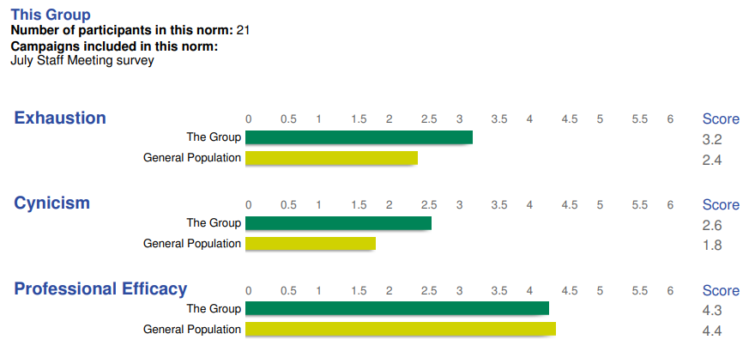
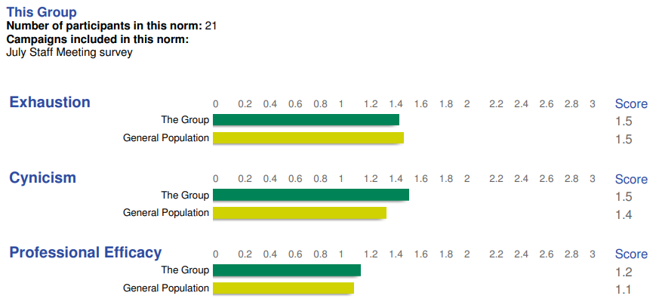
Burnout
more than just a bad day!
Seth Petry-Johnson
Rolling out the MBI to your team
Burnout Inventory Manual
$50.00 – Only need 1
Average scale scores
Required
Transform Survey Hosting
$2.50 per person
Individual Report
$2.50 per person
Pick one (or both)
Group Report
$200 per report
MindGarden.com
Notes:
The group report doesn’t contain a ton of data, but it does compare your overall group results to the overall population norm, which gives you an overview of how burnout is affecting the group.
In July of 2021, there were 19,000 other people in the general population dataset, and my company was scoring significantly higher on the Exhaustion and Cynicism scales as compared to them.
One of the challenges with interpreting this data, however, is that it wasn’t calibrated for COVID; the reports told us we were suffering from some widespread burnout, but so were most people. This comparison didn’t tell us whether we were doing better or worse than other companies during COVID
Since July of 2021 the general population dataset has grown by about 3000 people, so if you run this survey today you’re going to see some of those COVID effects start to be baked into the data.

Slide 84
Burnout
more than just a bad day!
Seth Petry-Johnson
Rolling out the MBI to your team
Burnout Inventory Manual
$50.00 – Only need 1
Standard deviations
Required
Transform Survey Hosting
$2.50 per person
Individual Report
$2.50 per person
Pick one (or both)
Group Report
$200 per report
MindGarden.com
Notes:
The other useful part of the group report is the standard deviation summary, which gives you a measure of how much variation there is within your group.
A standard deviation of 0 would mean that everyone answered the questions in exactly the same way, and the further the number gets from 0 the more variation there is.
If you see standard deviations well above the population norm, that is a sign that some people in your group are having a very different experience from the others, and that might be something worth troubleshooting through the individual reports.

Slide 85
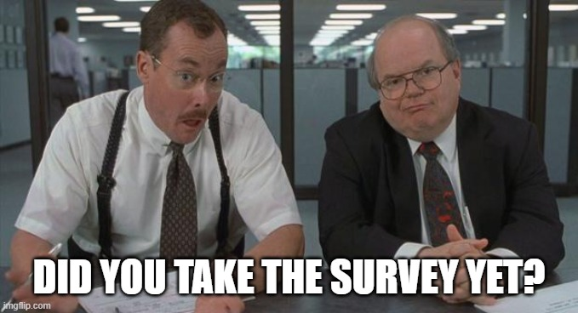
Burnout
more than just a bad day!
Seth Petry-Johnson
Rolling out the MBI to your team
Burnout Inventory Manual
$50.00 – Only need 1
Transform Survey Hosting
$2.50 per person
Total cost for my 22 person survey was ~$650
Individual Report
$2.50 per person
Group Report
$200 per report
MindGarden.com
Notes:
The total cost for rolling this out to my 22-person company was a little under $650, which really isn’t bad for the amount of data and insight it provided and for the improvements it enabled us to make, which I’ll talk about in a minute.

Slide 86
Burnout
more than just a bad day!
Seth Petry-Johnson
Rolling out the MBI to your team
Burnout Inventory Manual
$50.00 – Only need 1
Transform Survey Hosting
$2.50 per person
Total cost for my 25 person company was $xxx
Individual Report
$2.50 per person
Group Report
$200 per report
MindGarden.com
Notes:
But before I get to that, let’s talk about how you roll it out after you’ve purchased the survey licenses.
If you aren’t careful with how you introduce this to people, there’s a very real risk that it will skew the data you receive.
You’re basically asking employees to be vulnerable, and they may not be comfortable doing that if they’re afraid it will hurt their career if the results show them as anything except highly motivated, engaged, and productive.
The MBI manual provides some suggestions for addressing these concerns.

Slide 87
Burnout
more than just a bad day!
Seth Petry-Johnson
Rolling out the MBI to your team
Use a neutral facilitator
MindGarden.com
Notes:
First, they recommend that the survey be handled by a neutral facilitator that does NOT have direct authority over the respondents, to ensure more candid responses.

Slide 88
Burnout
more than just a bad day!
Seth Petry-Johnson
Rolling out the MBI to your team
Use a neutral facilitator
Do not describe as a “burnout” assessment
MindGarden.com
Notes:
Secondly, they recommend that you do not use the word “burnout” when introducing this. This is because people have widely varying beliefs about burnout, and using that word can bias their responses.
They recommend that you explain the survey as measuring job-related attitudes instead.
Once the measurements have been taken, of course, it’s appropriate to explain burnout and how the MBI is being used to measure it, you just want to avoid using the term “burnout” before the survey is taken.

Slide 89
Burnout
more than just a bad day!
Seth Petry-Johnson
Rolling out the MBI to your team
Use a neutral facilitator
Do not describe as a “burnout” assessment
Minimize response bias
MindGarden.com
Notes:
In addition to introducing the survey as relating to general job attitudes, another way to minimize response bias is to stress the importance of giving honest answers….

Slide 90
Burnout
more than just a bad day!
Seth Petry-Johnson
Rolling out the MBI to your team
Use a neutral facilitator
Do not describe as a “burnout” assessment
Minimize response bias
Ensure confidentiality
MindGarden.com
Notes:
… and one way to obtain honest answers is to reassure respondents about the confidentiality of the results.
MindGarden has an option for delivering the survey anonymously, and it’s even possible to set it up so that the respondents get a copy of their individual report, but no one else is able to link their specific results back to their identity.

Slide 91
Burnout
more than just a bad day!
Seth Petry-Johnson
Rolling out the MBI to your team
Use a neutral facilitator
Do not describe as a “burnout” assessment
Now what?
Minimize response bias
Ensure confidentiality
Voluntary participation
MindGarden.com
Notes:
Lastly, ethical use of a survey like this means it needs to be voluntary. You can’t coerce people into participating.
Tell your teams in advance how the data will be used and the benefits of participating, and then let them make an informed choice. Not participating needs to be a valid option.

Slide 92

Burnout
more than just a bad day!
Seth Petry-Johnson
Putting the data to use
Exhaustion
Now what?
Cynicism
Low Efficacy
Use a neutral facilitator
Do not describe as a “burnout” assessment
MindGarden.com
Minimize response bias
Ensure confidentiality
Voluntary participation
Notes:
OK, so we’ve established an understanding of what burnout is and we’ve talked about a way of measuring it across these three different scales.
But in order for those measurements to be worth anything, we have to actually do something with them…

Slide 93
Burnout
more than just a bad day!
Seth Petry-Johnson
Putting the data to use
Discuss in your 1-1s
Exhaustion
Cynicism
Low Efficacy
Notes:
… and your existing 1-1 meetings are a great place to start.
We had confidential individual reports sent directly to employees, so we asked each person to prepare for an upcoming 1-1 by choosing what they wanted to share with their manager.
Some people chose to forward the full report in advance, which was great. Others chose to summarize the results, without sharing the actual report. Some felt that the report was very inaccurate for them and chose not to share it, in which case we could talk about their way of thinking about burnout.
Once we knew each person’s burnout profile, we could tailor a response to their specific situation.

Slide 94
Burnout
more than just a bad day!
Seth Petry-Johnson
11
Putting the data to use
Discuss in your 1-1s
Exhaustion
Cynicism
Low Efficacy
Notes:
For instance, one of my developers was profiled as “Overextended”, which is characterized by frequent feelings of exhaustion and being used up.
He had a newborn child at home, so it didn’t take a genius to figure out where all of his energy was going, but we still wanted to find a way of reducing the stress he was feeling as a result of that situation.

Slide 95
Burnout
more than just a bad day!
Seth Petry-Johnson
11
Putting the data to use
Discuss in your 1-1s
Exhaustion
Adjust workload / expectations / PTO
Cynicism
Low Efficacy
Notes:
In his case, we adjusted his workload and expectations to give him space to recharge. I worked with the team to make sure he didn’t take on any critical path stories and instead focused his capacity on things that were important, but weren’t urgent or time sensitive. This gave him some freedom to use PTO in unplanned ways, such as coming in late after a night of no sleep, without worrying that he was dropping a ball someone else would need to pick up
He was still productive, he was still working on stuff we needed to get done, and the team was still meetings its objectives. At the same time, he had flexibility to take advantage of opportunities to replenish his stores of adaptation energy. All it took was a little bit of intentional planning and collaboration.

Slide 96
Burnout
more than just a bad day!
Seth Petry-Johnson
Putting the data to use
Exhaustion
Cynicism
Show that their work matters
Low Efficacy
Notes:
If someone has the “Disengaged” profile, it means they’ve either lost enthusiasm about the work they do, or they don’t think what they do actually matters.
(click) As a leader, you have power to directly address these feelings by showing them how their work makes a difference.
Even if they are a relatively low-level employee doing a routine or mundane task, you can still express sincere appreciation that the task is being done well so that you can focus on other things.
If they’re doing something important but that they don’t really enjoy, make sure they know you see them doing it. Thank them for doing the task well, even though it isn’t rewarding by itself. Every once in awhile, give them a Starbucks gift card or something to say thanks; even a little bit of appreciation goes a long way.
And as an aside, if as a manager or leader you can’t sincerely appreciate something about their work, then you yourself could be contributing to their cynicism.

Slide 97
Burnout
more than just a bad day!
Seth Petry-Johnson
Putting the data to use
Exhaustion
Show that their work matters
Cynicism
Close the feedback loops
Low Efficacy
Notes:
Also, make sure you have closed feedback loops that make each person’s impact easier for them to see.
For instance, one of my developers clearly takes pride in making things easier to use and understand. It came up during his onboarding, it’s come up in our 1-1 coaching sessions, etc.
His sense of accomplishment is so intrinsically bound to making things easy to use and understand, that it doesn’t really matter how many “points” he ships, or how many tests he writes, or how many users we can support, or what our revenue looks like; if he doesn’t know that his work is making things easier on our users, he starts to question whether he’s doing good work or not.
I could just tell him every 3rd or 4th 1-on-1 that he’s making things better, but it’s much more powerful to set up a feedback loop that doesn’t require me to be in the middle.
For example, I’ve started doing regular feature demos for the team of analysts that uses our product. I make sure to invite the product team to those demos, even though they already know how the feature looks and works, because I want them to hear the feedback from one set of end users for themselves.
The specific steps you take might be different for each person; step 1 is to figure out how they view success, and step 2 is to create some sort of feedback loop that’s targeted for their perspective.

Slide 98
Burnout
more than just a bad day!
Seth Petry-Johnson
Putting the data to use
Exhaustion
Cynicism
Low Efficacy
Feedback loops
Notes:
If one of your team members receives the “Ineffective” profile, remember that this does not mean they are actually ineffective at their job, and you should definitely reinforce them with them.
It just means that their feelings of inefficacy are leading to burnout, and again knowing this gives us clues about how to address it.
(click)
Feedback loops are really important here too, but in this case the feedback is less about external outcomes and more about productivity or quality or whatever other metric the team uses to evaluate itself.
If someone feels like they’re too slow, what are they basing it on? Are there metrics about speed that are being captured? Are those metrics being shared so that people are basing their feelings on actual data, rather than assumptions?

Slide 99
Burnout
more than just a bad day!
Seth Petry-Johnson
Putting the data to use
Exhaustion
Cynicism
Low Efficacy
Feedback loops / realistic metrics
Notes:
It’s also really important to make sure that those metrics and goals are realistic and appropriate.
Let’s say you have two developers on your team;
Keisha believes in collaboration and early feedback. She finishes her stories very quickly and aggressively pushes them into QA for validation and to get other eyes on the work. Typically QA finds something, meets with her to go over it and agree on a solution, and then Keisha pulls it back into development for updates.
Your other developer John is much slower to push stories into QA. He really likes to take his time, think through all the possibilities, anticipate what QA might do, etc. It takes his work longer to move through the process, but his stories rarely need any rework after he’s done.
If your metrics and internal feedback loops focus only on the initial development time, or only count developer hours, then John would have a good reason to start feeling ineffective at work. The data that everyone sees says he’s slow, and after awhile he starts to believe it.
More realistic metrics would look at the overall cycle time and would include the number of hours spent by developers AND by testers to fully complete a story. Those metrics might show that, despite their differences, John and Keisha are equally effective at supporting the overall team flow.

Slide 100
Burnout
more than just a bad day!
Seth Petry-Johnson
Putting the data to use
Exhaustion
Cynicism
Feedback loops / realistic metrics
Low Efficacy
Imposter syndrome / realistic goals
Notes:
Imposter syndrome is another possible culprit for feelings of low efficacy, and again this is something you can troubleshoot in a 1-1.
An example of this is a developer on my team named Scott. Scott has been with my company for over 20 years, he’s a legit genius, he can context switch without penalty unlike anybody else I’ve ever met, he never forgets anything, and he’s incredibly productive. He’s an absolute superstar, but that can be a double-edged sword.
It’s very natural that when you’re working closely with someone you start to compare how you do things with that person. Well, when Scott pairs with other developers, especially those earlier in their career, they very quickly realize how slow they are or how little they know in comparison to Scott.
As a manager and leader, it’s part of my job to remind them that everyone is slower than Scott and knows less than Scott.
When working with someone with this profile, set realistic goals for that person; make sure they are using the correct yardstick to measure the quality of their process and work product.

Slide 101
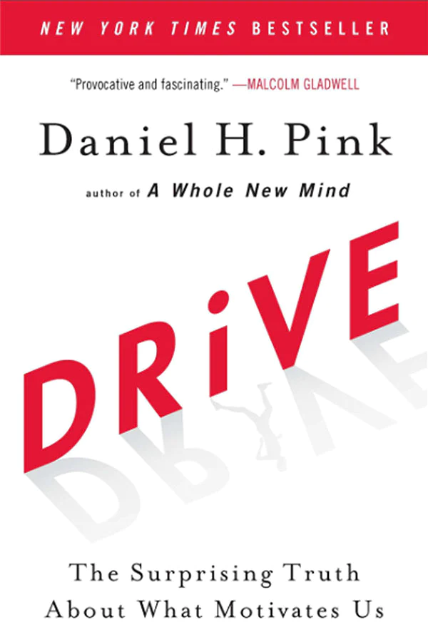
Burnout
more than just a bad day!
Seth Petry-Johnson
Putting the data to use
Exhaustion
Cynicism
Feedback loops / realistic metrics
Low Efficacy
Imposter syndrome / realistic goals
Training
Notes:
Lastly, don’t sleep on the value of training to help people feel more effective by actually making them more effective.
Pluralsight, SkillShare, Coursera, there are tons of extremely affordable online learning resources. Use one of your 1-1s to look through the course listings together and find something that appeals to the employee as well as to you, then pay for it and give them an hour or two a week to work through the material on the clock.

Slide 102
Burnout
more than just a bad day!
Seth Petry-Johnson
Putting the data to use
Exhaustion
Cynicism
Low Efficacy
Notes:
One final way to use the MBI data to address burnout is to think about burnout as the opposite of motivation. Motivation increases your reserves of adaptation energy while burnout depletes them.
Daniel Pink wrote this really well known book called Drive that explores how motivation works.
In his book, he identifies three factors driving intrinsic motivation in the workplace. They are Autonomy, Mastery, and Purpose.

Slide 103
Burnout
more than just a bad day!
Seth Petry-Johnson
Putting the data to use
Exhaustion
Autonomy
Cynicism
Mastery
Low Efficacy
Purpose
Notes:
Autonomy is the freedom and flexibility to do your job as you see fit. Micromanagement is so demotivating because it robs us of autonomy.
Mastery is the desire that we have to grow and develop with our careers. People want to get better. They want to earn a raise. They want to increase their standing amongst their peers. They want to feel like they’ve mastering their trade or their craft or their role.
And Purpose is about knowing the goal or the reason for doing something. A connection to purpose gives our work meaning, it inspires us to push through adversity and hardship and to succeed where others would fail.

Slide 104
Burnout
more than just a bad day!
Seth Petry-Johnson
Putting the data to use
Exhaustion
Autonomy
Cynicism
Mastery
Low Efficacy
Purpose
Today’s agenda
Understanding burnout
Diagnosing and measuring burnout
Treating / managing burnout
Notes:
I think you can draw some pretty clear parallels between these two models.
One way to combat exhaustion is by giving employees more autonomy in how they do their work, because it gives them more flexibility in how they balance all of the different demands on their time. That’s how I helped the developer with the newborn child, by giving him more autonomy in setting his working hours

Slide 105
Burnout
more than just a bad day!
Seth Petry-Johnson
Putting the data to use
Exhaustion
Autonomy
Cynicism
Mastery
Low Efficacy
Purpose
Today’s agenda
Understanding burnout
Diagnosing and measuring burnout
Treating / managing burnout
Notes:
One way to combat cynicism and disengagement is by strengthening someone’s connection to purpose. I’m not super enthusiastic about my people management role, but I know that it’s critically important for my company and doing that role connects me to my purpose of building a very productive and healthy team.

Slide 106
Burnout
more than just a bad day!
Seth Petry-Johnson
Putting the data to use
Exhaustion
Autonomy
Cynicism
Mastery
Low Efficacy
Purpose
Today’s agenda
Understanding burnout
Diagnosing and measuring burnout
Treating / managing burnout
Notes:
And helping your people become masters of their tools, or their craft, and helping them to become known as masters of their craft, is a great way to combat feelings of inefficacy and imposter syndrome.
I’m not going to dwell on this connection, but Drive is a good book and I think it’s a great complement to the burnout concepts we’ve been discussing.
It was also written more recently than the 1980s…

Slide 107
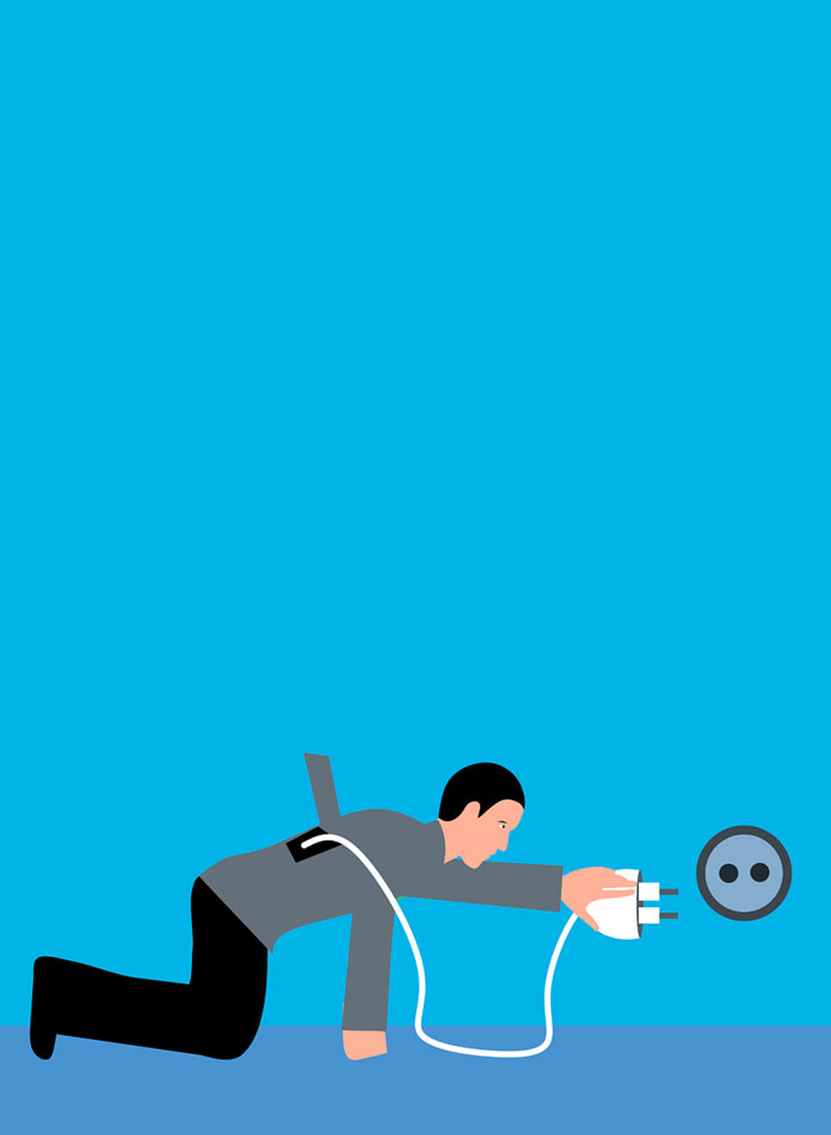

How it’s going
Putting the data to use
Burnout
more than just a bad day!
Seth Petry-Johnson
Exhaustion
Today’s agenda
Autonomy
Understanding burnout
Cynicism
Mastery
Diagnosing and measuring burnout
Low Efficacy
Treating / managing burnout
Purpose
Notes:
OK, so we’ve talked a bit about what burnout is, we talked about using the Maslach Burnout Inventory to measure burnout, and I shared some ideas on how to use what you learn from the MBI to develop targeted, intentional strategies to reduce it.
One last question you might have is, did any of this actually matter to my organization? Did it move the needle?
If this image represented us at the start of this project, then maybe the “after” image is more like this…

Slide 108
Burnout
more than just a bad day!
Seth Petry-Johnson
How it started
How it’s going
Understanding burnout
Diagnosing and measuring burnout
Treating / managing burnout
Notes:
Which is to say that things ARE better, and we’re moving in a better direction, but it takes time. This isn’t a silver bullet.
It’s a bit like an Agile transformation; adopting retrospectives and shorter feedback loops doesn’t magically make your process better, or magically eliminate technical debt, or magically let you hit all of your deadlines. Instead, an agile transformation shines light on the problems that already exist and gives you a framework for addressing them.
And that’s basically what rolling out the MBI does as well; it shines light on the burnout your people are already experiencing and gives you a framework for understanding and addressing the causes, but you still have to do the hard work. You have to hold the 1-1s, you have to meet people where they are, and you have to care enough to make the changes that are needed to address each person’s primary stressors.

Slide 109

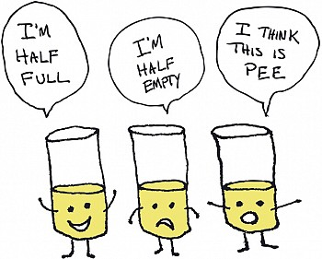
Burnout
more than just a bad day!
Seth Petry-Johnson
How it started
How it’s going
It’s OK if not everyone buys in!
Turnover crisis avoided
Improved morale
Better equipped to treat future burnout
Notes:
We stabilized our turnover crisis, we retained all of our key people, and morale got better.
I’m not saying that this burnout survey is 100% responsible for those things; they are the results of many different decisions made my many different people across our organization’s management layer.
(click) But one thing the burnout survey IS responsible for is giving us a shared language to use when talking about burnout, and that’s really helpful to managers like me because it gives me tools to spot and address burnout early, before it hits a crisis stage.

Slide 110
Burnout
more than just a bad day!
Seth Petry-Johnson
How it started
How it’s going
It’s OK if not everyone buys in!
Turnover crisis avoided
Improved morale
Better equipped to treat future burnout
Notes:
Not everyone bought into this model, and that’s OK.
Some of our staff leaned into the project, took the concepts to heart, and found their report useful.

Slide 111
Burnout
more than just a bad day!
Seth Petry-Johnson
How it’s going
It’s OK if not everyone buys in!
Turnover crisis avoided
Improved morale
Better equipped to treat future burnout
Notes:
Other people could take it or leave it. They participated, but at the end of the day didn’t change a lot of their behavior.

Slide 112
https://bit.ly/BurnoutTalk
Burnout
more than just a bad day!
Seth Petry-Johnson
Burnout is lost energy (Exhaustion)
Burnout is lost enthusiasm (Cynicism)
How it’s going
It’s OK if not everyone buys in!
Burnout is lost confidence (Efficacy)
Turnover crisis avoided
Improved morale
Better equipped to treat future burnout
Diagnosing and measuring burnout
Treating / managing burnout
Notes:
And a few people actively resisted, either because they thought the whole idea was bunk or because they felt the survey was totally inaccurate for them.
But even the people that didn’t buy in still benefitted, the project gave the management team insights that we can use to improve their quality of life at work.
And regardless of which model of burnout you ascribe to, and regardless of how you measure it, improving someone’s quality of life at work is going to reduce their experience of burnout.

Slide 113
Burnout
more than just a bad day!
Seth Petry-Johnson
https://bit.ly/BurnoutTalk
Key takeaways
Burnout is a response to chronic stress
Burnout is lost energy (Exhaustion)
Burnout is lost enthusiasm (Cynicism)
Use the Maslach Burnout Inventory from mindgarden.com to measure feelings of Exhaustion / Cynicism / Professional Efficacy
Burnout is lost confidence (Efficacy)
Discuss individual burnout profiles in weekly 1-on-1s to create targeted solutions
How it’s going
Turnover crisis avoided
Don’t expect magical results; but if you do the work, things will improve
Improved morale
Better equipped to treat future burnout
petryjohnson@gmail.com / @spetryjohnson
Diagnosing and measuring burnout
Treating / managing burnout
Notes:
Here’s a link to my slides and my references on GitHub as well as the key takeaways for your screen-shotting pleasure.
https://bit.ly/BurnoutTalk

Slide 114
Burnout
more than just a bad day!
Seth Petry-Johnson
https://bit.ly/BurnoutTalk
Key takeaways
Burnout is a response to chronic stress
Burnout is lost energy (Exhaustion)
Burnout is lost enthusiasm (Cynicism)
Use the Maslach Burnout Inventory from mindgarden.com to measure feelings of Exhaustion / Cynicism / Professional Efficacy
Burnout is lost confidence (Efficacy)
Discuss individual burnout profiles in weekly 1-on-1s to create targeted solutions
How it’s going
Turnover crisis avoided
Don’t expect magical results; but if you do the work, things will improve
Improved morale
I’m hiring!
Developer:
bit.ly/AwesomeJobForDevs
Better equipped to treat future burnout
petryjohnson@gmail.com / @spetryjohnson
Test Engineer:
bit.ly/AwesomeJobForTester
Diagnosing and measuring burnout
Treating / managing burnout
Notes:
Here’s a link to my slides and my references on GitHub as well as the key takeaways for your screen-shotting pleasure.
https://bit.ly/BurnoutTalk

Slide 115
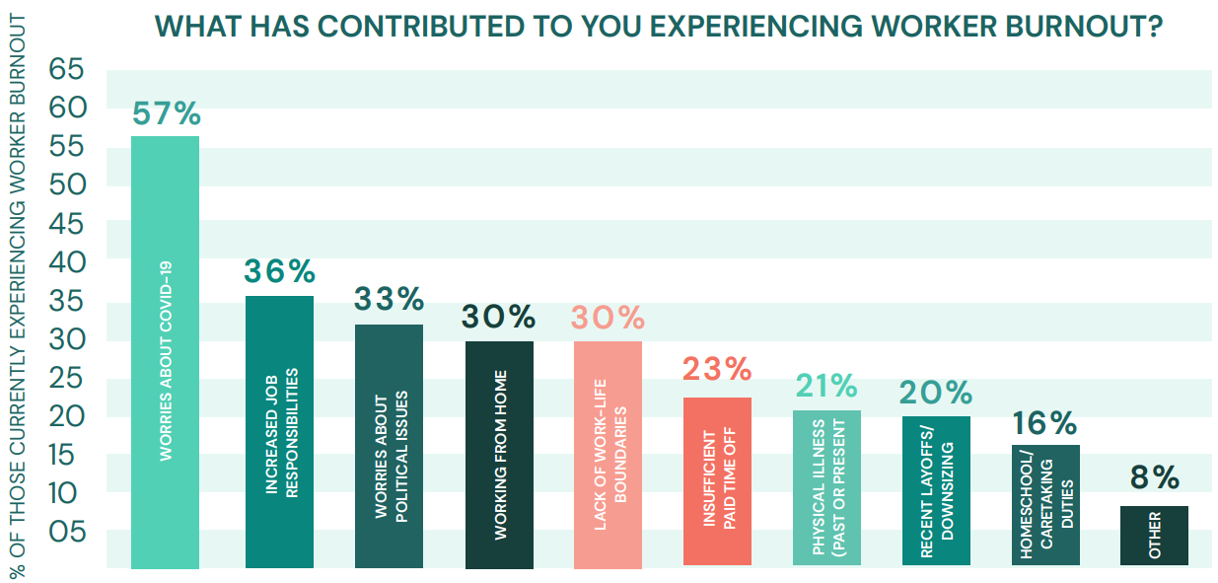
Burnout
more than just a bad day!
Seth Petry-Johnson
Understanding burnout
Employed Americans w/ no ideas for reducing burnout
2020
1 in 10
Notes:
And 1 in 10 workers reported having no ideas at all about how they might reduce burnout for themselves or others.

Slide 116
Burnout
more than just a bad day!
Seth Petry-Johnson
Understanding burnout
2023?
Notes:
And 1 in 10 workers reported having no ideas at all about how they might reduce burnout for themselves or others.

